Slide 1

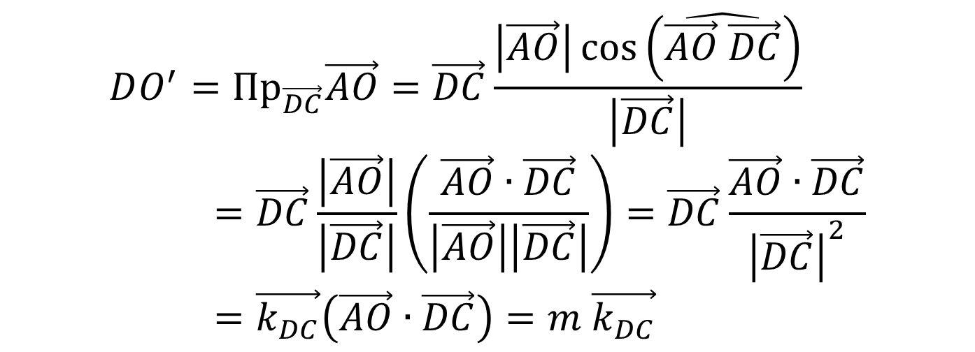

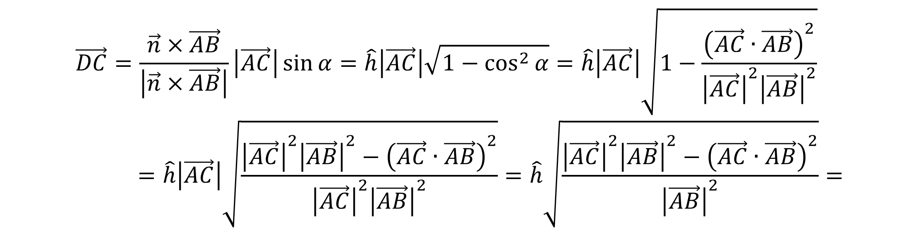
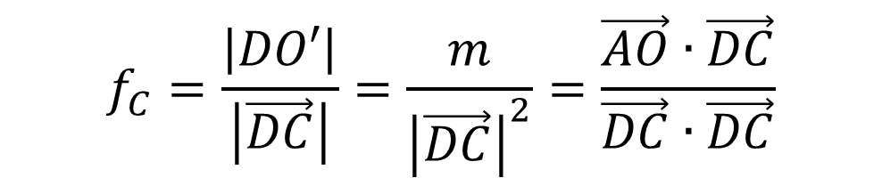
C
$${DO^{′}=Пр}_{\vec{DC}}\vec{AO}=\vec{DC}\frac{\left|\vec{AO}\right|\cos\left(\hat{\vec{AO} \vec{DC}}\right)}{\left|\vec{DC}\right|}=\vec{DC}\frac{\left|\vec{AO}\right|}{\left|\vec{DC}\right|}\left(\frac{\vec{AO}∙\vec{DC}}{\left|\vec{AO}\right|\left|\vec{DC}\right|}\right)=\vec{DC}\frac{\vec{AO}∙\vec{DC}}{{\left|\vec{DC}\right|}^{2}}=\vec{k_{DC}}\left(\vec{AO}∙\vec{DC}\right)=m \vec{k_{DC}}$$
O
O’
$$α$$
$$\hat{h}$$
A
D
B
При $m=\vec{AO}∙\vec{DC}<0$ точка O лежит вне треугольника
$$f_{C}=\frac{\left|DO′\right|}{\left|\vec{DC}\right|}=\frac{m}{{\left|\vec{DC}\right|}^{2}}=\frac{\vec{AO}∙\vec{DC}}{\vec{DC}∙\vec{DC}}$$
$$\vec{DC}=\frac{\vec{n}×\vec{AB}}{\left|\vec{n}×\vec{AB}\right|}\left|\vec{AC}\right|\sin{α}=\hat{h}\left|\vec{AC}\right|\sqrt{1−\cos^{2}{α}}=\hat{h}\left|\vec{AC}\right|\sqrt{1−\frac{{\left(\vec{AC}∙\vec{AB}\right)}^{2}}{{\left|\vec{AC}\right|}^{2}{\left|\vec{AB}\right|}^{2}}}=\hat{h}\left|\vec{AC}\right|\sqrt{\frac{{\left|\vec{AC}\right|}^{2}{\left|\vec{AB}\right|}^{2}−{\left(\vec{AC}∙\vec{AB}\right)}^{2}}{{\left|\vec{AC}\right|}^{2}{\left|\vec{AB}\right|}^{2}}}=\hat{h}\sqrt{\frac{{\left|\vec{AC}\right|}^{2}{\left|\vec{AB}\right|}^{2}−{\left(\vec{AC}∙\vec{AB}\right)}^{2}}{{\left|\vec{AB}\right|}^{2}}}=$$

